Slide 1
Physics of Turbulent Channel Flow
Juhyun Kim
2020.12.17

Slide 2
Physics of Turbulent Channel Flow
Useful references
Mukha, T., & Liefvendahl, M. (2015). Large-Eddy Simulation of Turbulent Channel Flow.
Moin, P., & Kim, J. (1982). Numerical investigation of turbulent channel flow. Journal of fluid mechanics, 118, 341-377.

Slide 3
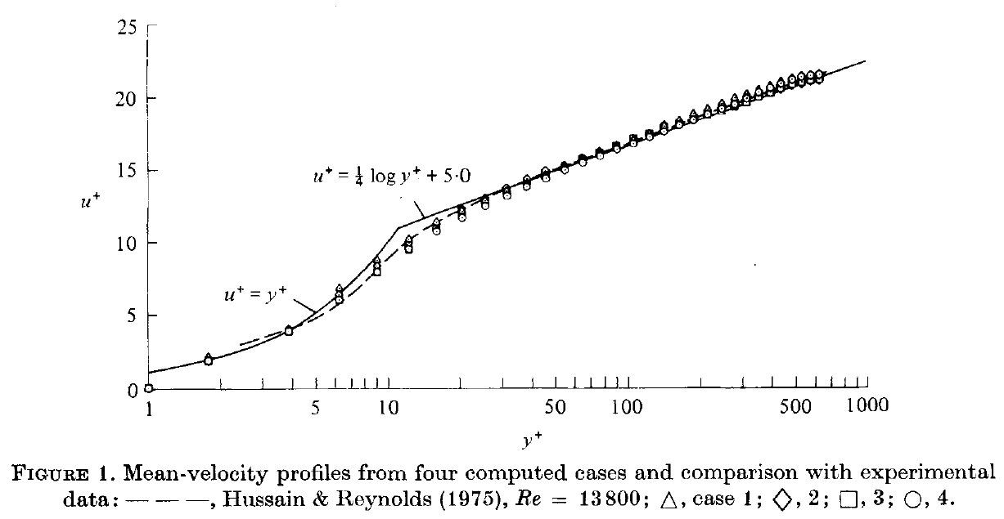
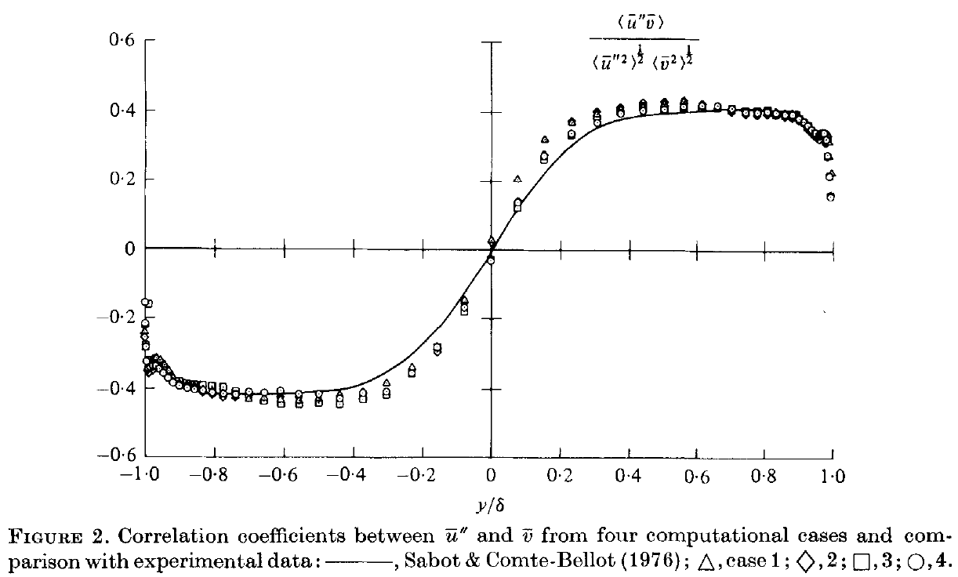
Physics of Turbulent Channel Flow
Mean velocity profile and turbulence statistics
Fine enough to produce a mean velocity profile which would be accurate enough for most engineering applications.
Buffer region
Log-law region
Viscous sub-layer

Slide 4
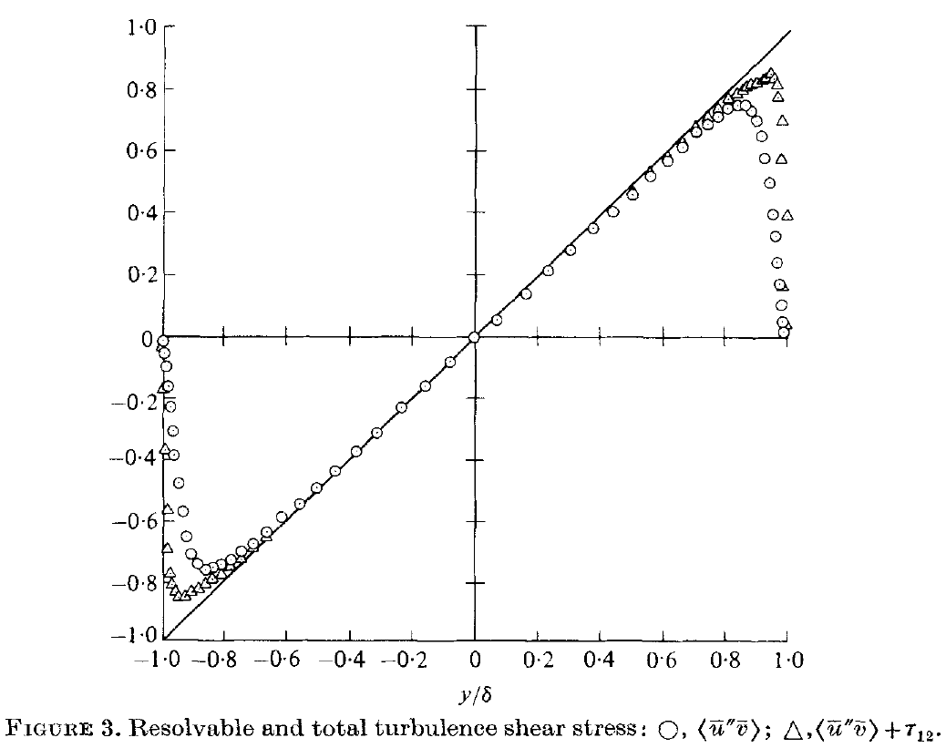



Physics of Turbulent Channel Flow
Turbulent shear stress
xz and yz components of the Reynolds stress tenser are equal to zero.
The sum of the viscous and turbulent shear stresses varies linearly across the channel.
Viscous stresses play a significant role only in the viscous wall region ($y^{+}<50$).
Outside of the viscous wall region, the profile of the turbulent shear stress is expected to be linear.
$$τ=ρν\frac{d\left\langle U\right\rangle }{dy}−ρ\left\langle uv\right\rangle$$
$$\frac{dτ}{dy}=\frac{dp_{w}}{dx}$$

Slide 5
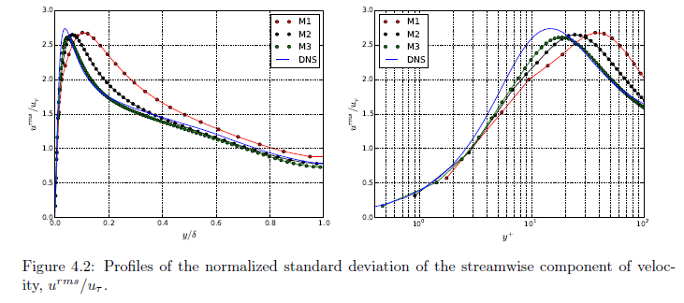
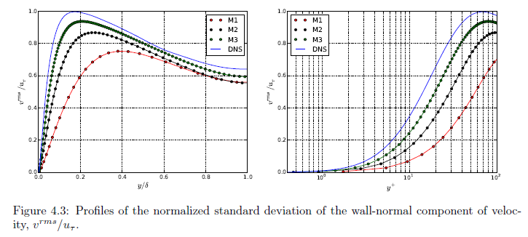
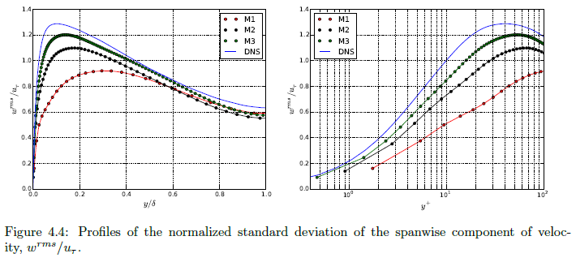
Physics of Turbulent Channel Flow
Velocity fluctuations

Slide 6
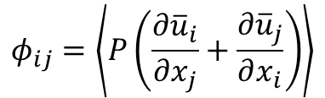
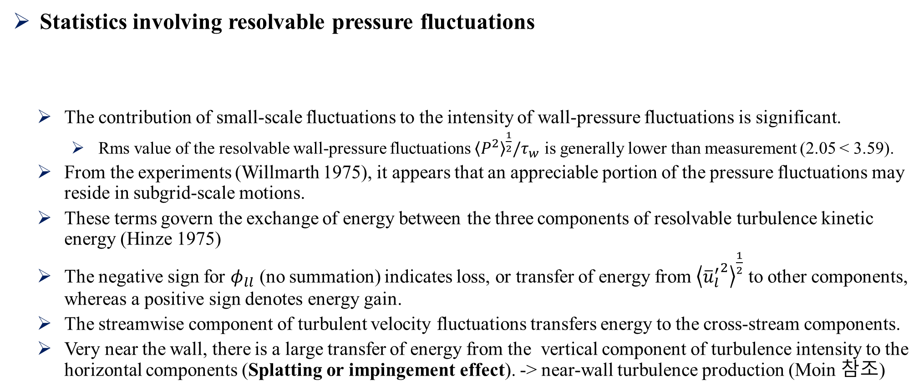
Physics of Turbulent Channel Flow
Statistics involving resolvable pressure fluctuations
The contribution of small-scale fluctuations to the intensity of wall-pressure fluctuations is significant.
Rms value of the resolvable wall-pressure fluctuations ${\left\langle P^{2}\right\rangle }^{\frac{1}{2}}/τ_{w}$ is generally lower than measurement (2.05 < 3.59).
From the experiments (Willmarth 1975), it appears that an appreciable portion of the pressure fluctuations may reside in subgrid-scale motions.
These terms govern the exchange of energy between the three components of resolvable turbulence kinetic energy (Hinze 1975)
The negative sign for $φ_{ll}$ (no summation) indicates loss, or transfer of energy from ${\left\langle {{\overline{u}}_{l}^{′}}^{2}\right\rangle }^{\frac{1}{2}}$ to other components, whereas a positive sign denotes energy gain.
The streamwise component of turbulent velocity fluctuations transfers energy to the cross-stream components.
Very near the wall, there is a large transfer of energy from the vertical component of turbulence intensity to the horizontal components (Splatting or impingement effect). -> near-wall turbulence production (Moin 참조)
$$φ_{ij}=\left\langle P\left(\frac{∂{\overline{u}}_{i}}{∂x_{j}}+\frac{∂{\overline{u}}_{j}}{∂x_{i}}\right)\right\rangle$$

Slide 7
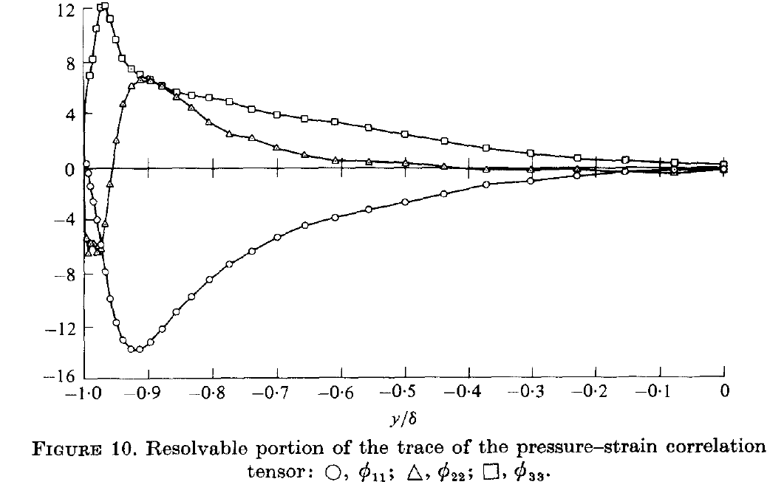
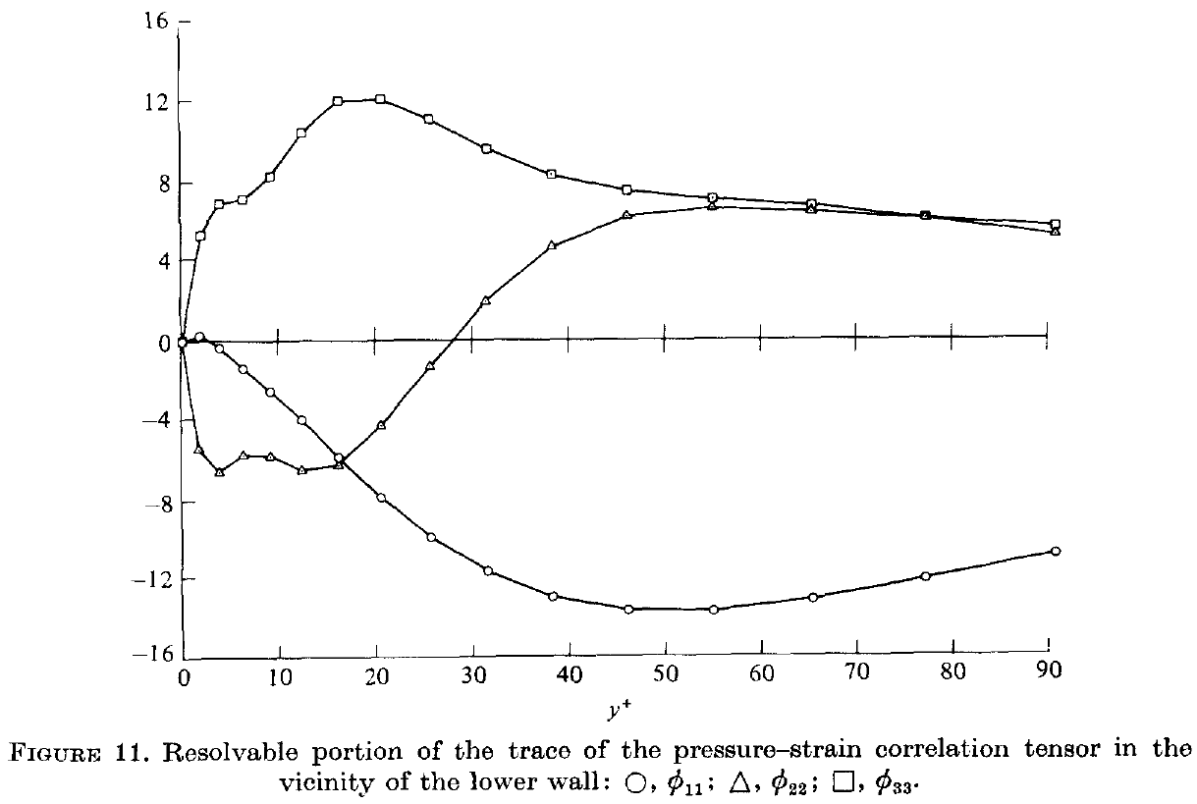
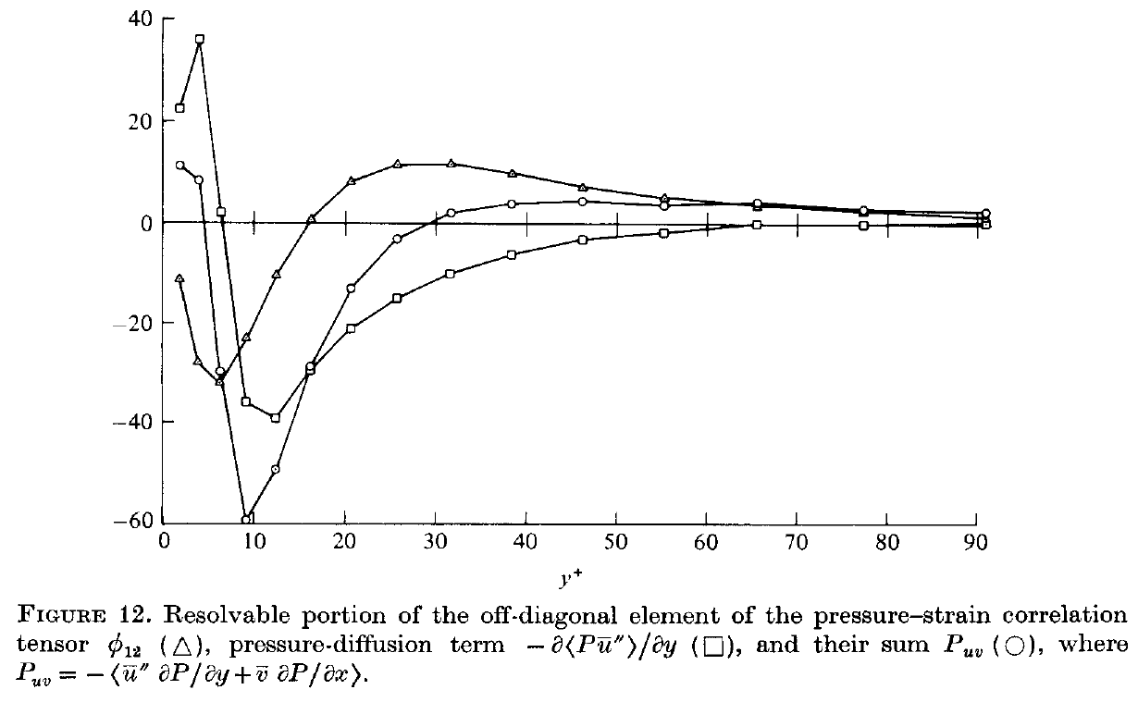
Physics of Turbulent Channel Flow
Statistics involving resolvable pressure fluctuations
Splatting

Slide 8
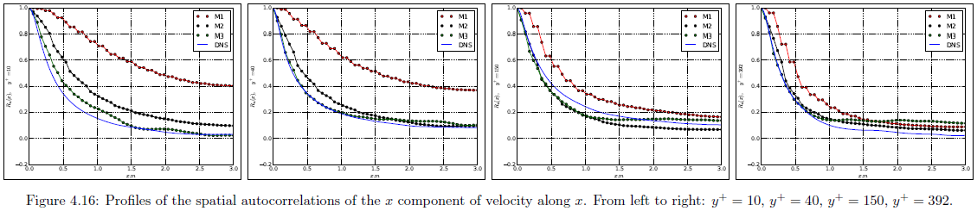
Physics of Turbulent Channel Flow
Two-point correlation functions
They can be used to compute integral length scales of the turbulent structures.
The domain is large enough, if the two-point correlations become negligibly small on the length scale of the domain, in the respective directions.
Longitudinal correlation in the streamwise direction extends over much longer distances than do all other correlations.
Near the wall, the eddies are highly elongated in the streamwise direction.
Near the walls, the computed flow field consists of elongated streaky structures.

Slide 9
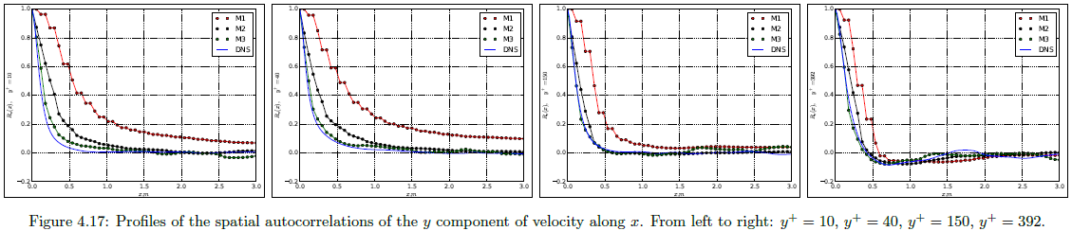
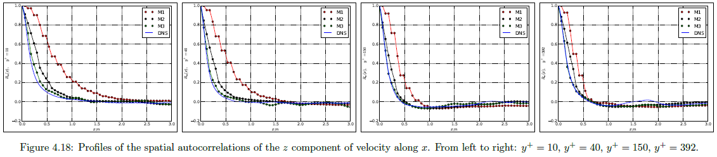
Physics of Turbulent Channel Flow
Two-point correlation functions

Slide 10
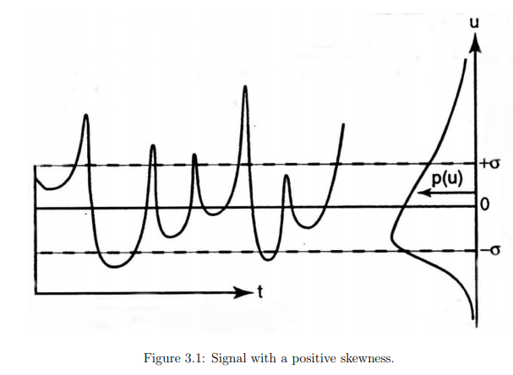
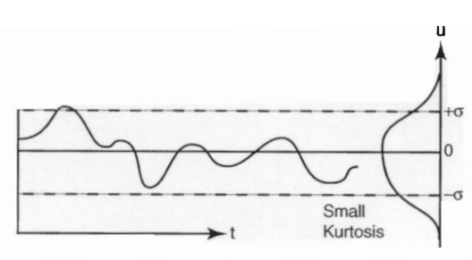
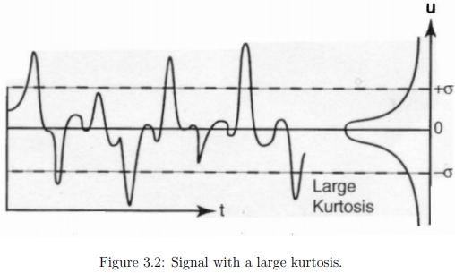
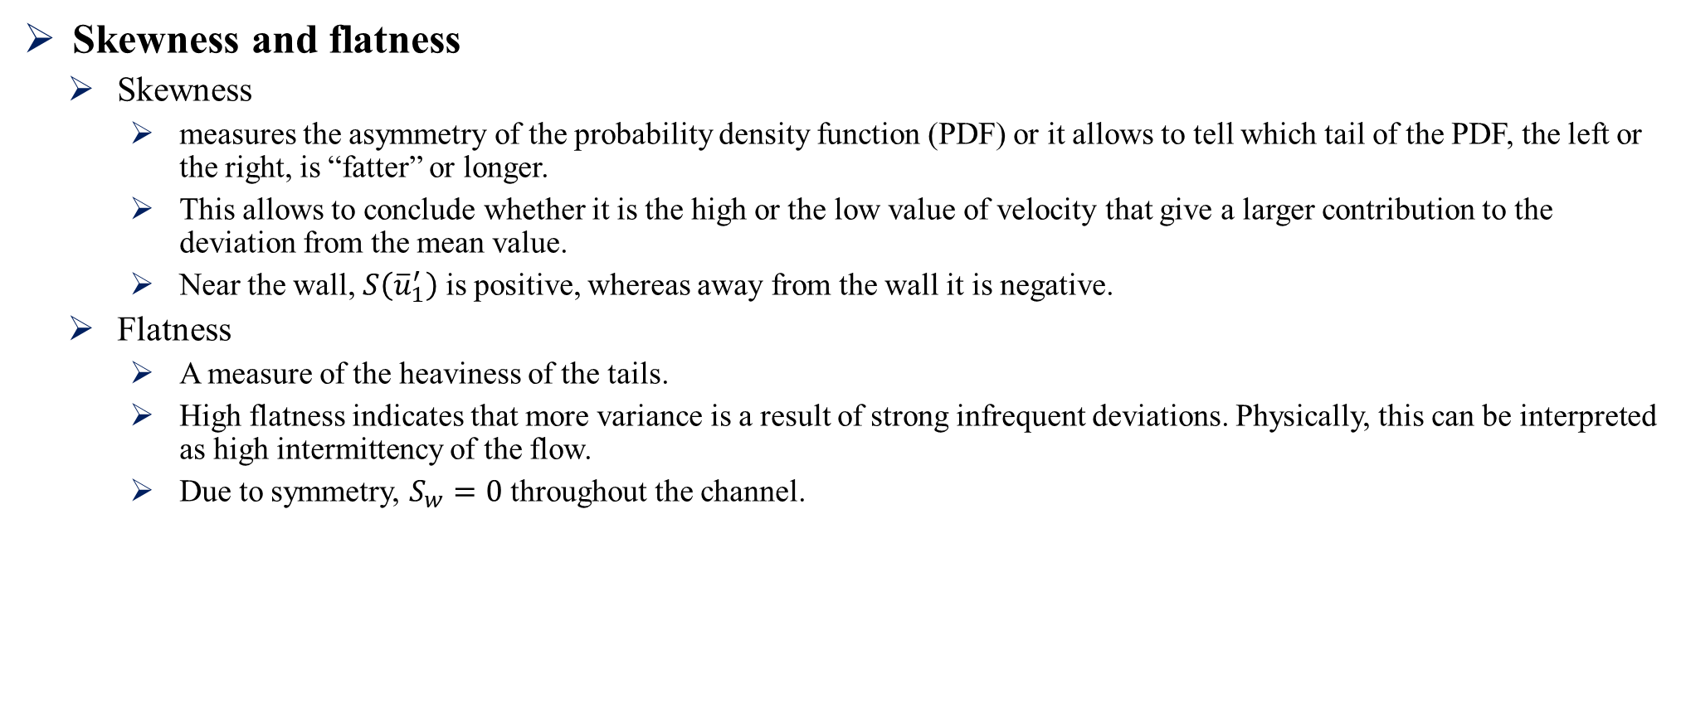
Physics of Turbulent Channel Flow
Skewness and flatness
Skewness
measures the asymmetry of the probability density function (PDF) or it allows to tell which tail of the PDF, the left or the right, is “fatter” or longer.
This allows to conclude whether it is the high or the low value of velocity that give a larger contribution to the deviation from the mean value.
Near the wall, $S\left({\overline{u}}_{1}^{′}\right)$ is positive, whereas away from the wall it is negative.
Flatness
A measure of the heaviness of the tails.
High flatness indicates that more variance is a result of strong infrequent deviations. Physically, this can be interpreted as high intermittency of the flow.
Due to symmetry, $S_{w}=0$ throughout the channel.

Slide 11
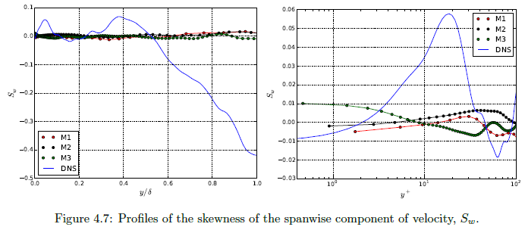
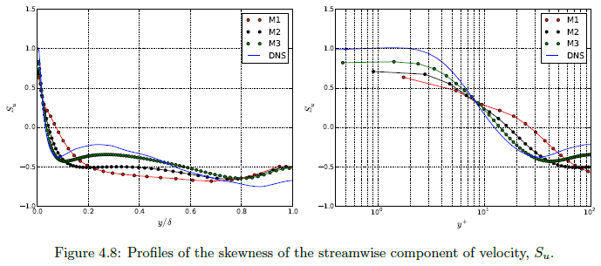
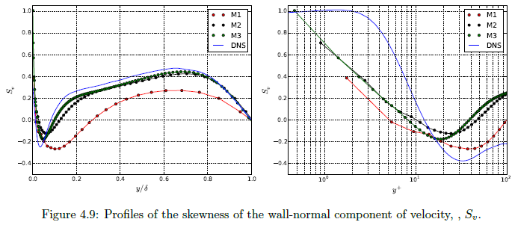
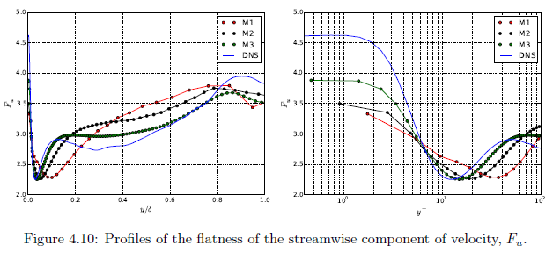
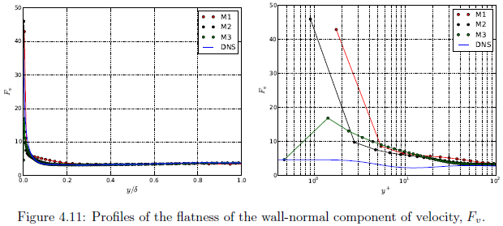
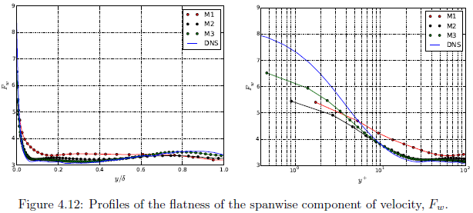
Physics of Turbulent Channel Flow
Skewness and flatness

Slide 12
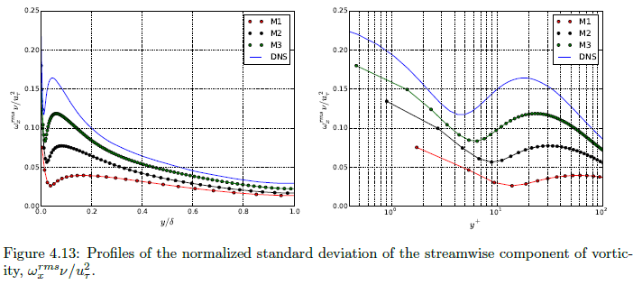
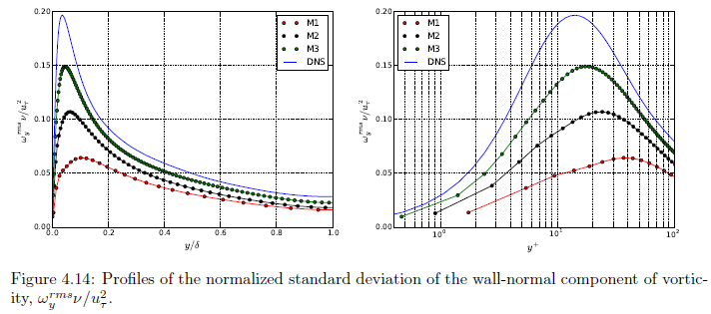

Physics of Turbulent Channel Flow
Vorticity fluctuations
The relative contribution of the small scales to vorticity fluctuations is significantly higher than to the velocity fluctuations.
All three components of $ω^{rms}$ have similar magnitude away from the channel walls due to the fact that the small scales tend to be isotropic in that region.
There exists a near-wall, streamwise vortical structure, that has its center located at the local maximum of $ω_{x}^{rms}$, and its edge at the local minimum.

Slide 13
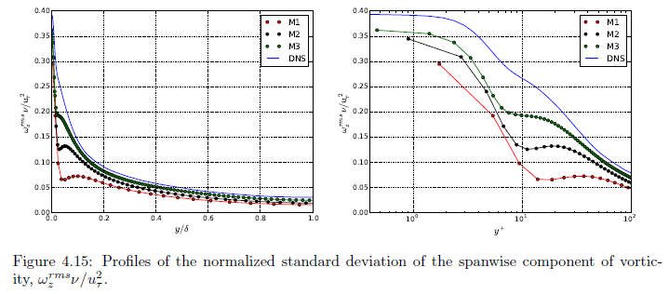
Physics of Turbulent Channel Flow
Vorticity fluctuations

Slide 14
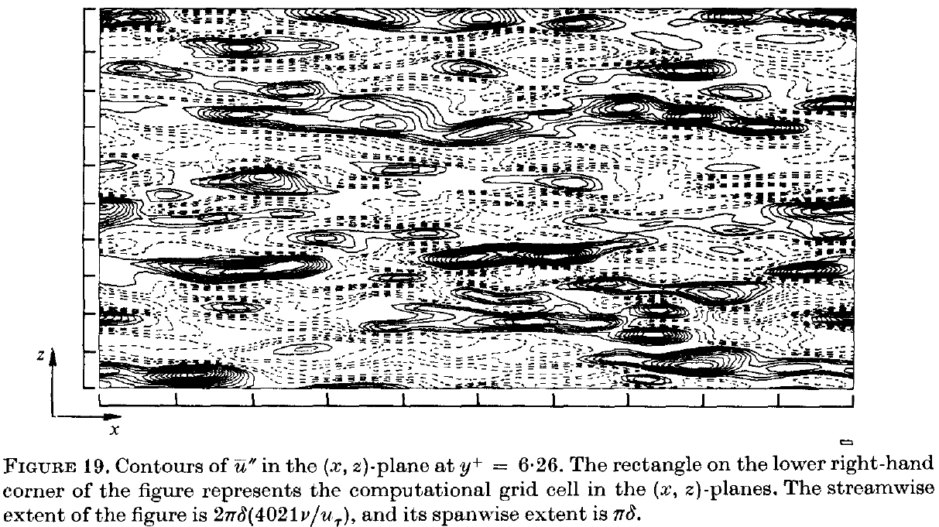
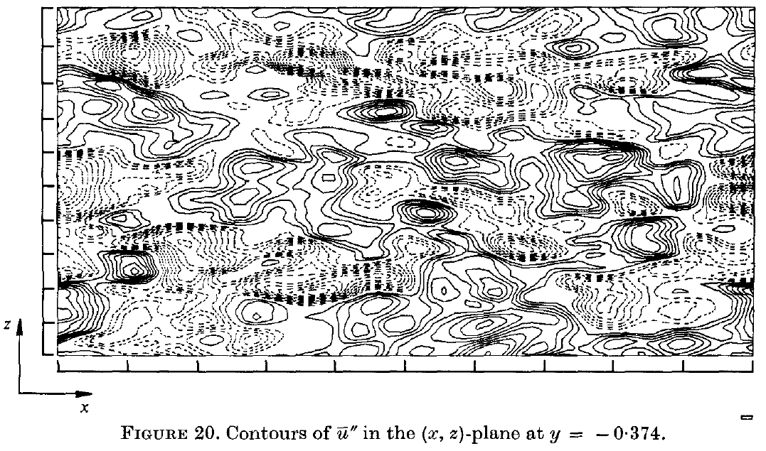
Physics of Turbulent Channel Flow
Detailed flow structures
The viscous sublayer consists of coherent structures of high- and low-speed streaks alternating in the spanwise direction.
Streaks are the unique characteristic of the wall-layer turbulence, and they are absent in the regions away from the walls.
< Near-wall >
< Far away from the wall >

Slide 15
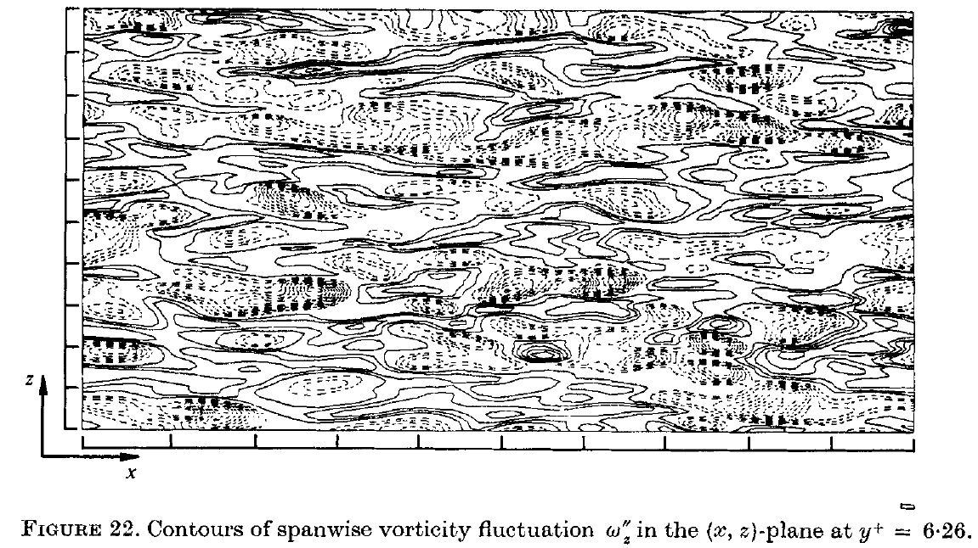

Physics of Turbulent Channel Flow
Detailed flow structure
Virtually all the regions with large vorticity fluctuations are associated with negative $ω_{z}^{′}$.
In these regions, the streamwise velocity profile has excess momentum with respect to the mean velocity.

Slide 16
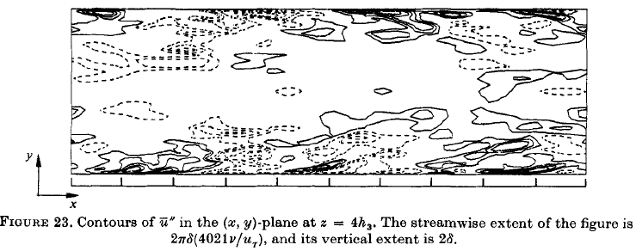
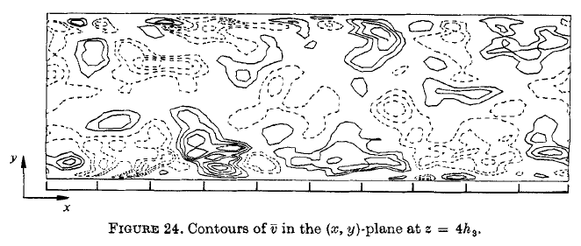

Physics of Turbulent Channel Flow
Detailed flow structure
In the vicinity of the walls, the high-speed fluid elements correspond to the sweep event, i.e. $\overline{v}<0$ near the lower wall, and $\overline{v}>0$ near the upper wall.
The low-speed fluid elements are generally being ejected from the wall regions.
Both the sweep and ejection events have a positive contribution to the production of turbulent kinetic energy.
High-speed structures near the walls are inclined at oblique angles with respect to the walls (Fig. 23). This is the consequence of the action of mean shear on any fluid element from the outer layers that is moving toward the walls. Inclination of these structures to be 13$°$.

Slide 17
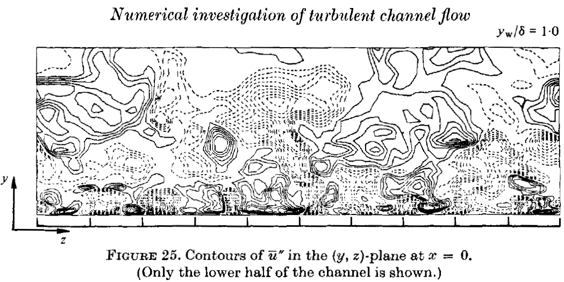
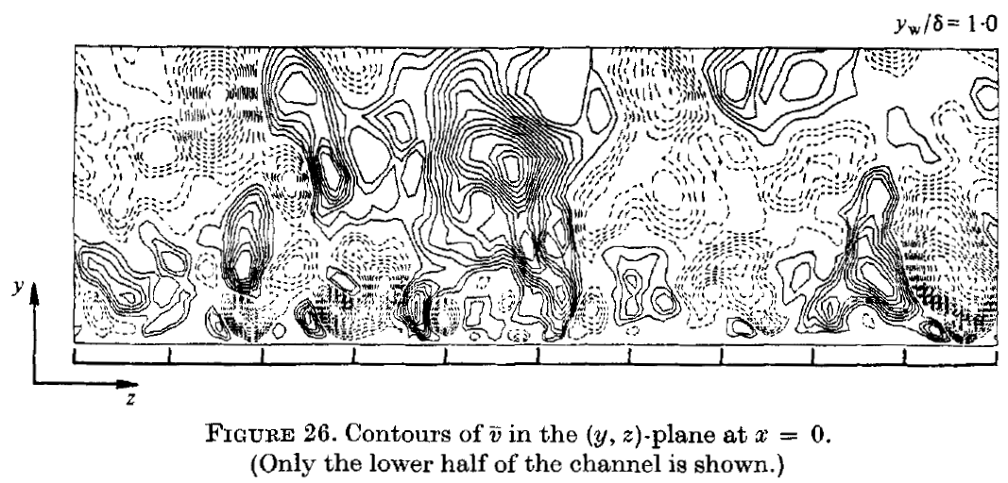

Physics of Turbulent Channel Flow
Detailed flow structure
Throughout a significant portion of the region displayed, there is a negative correlation between ${\overline{u}}^{′}$ and ${\overline{v}}^{′}$.
In the wall region, the vertical and spanwise extent of the eddies is significantly smaller than in the regions away from the wall.

Slide 18
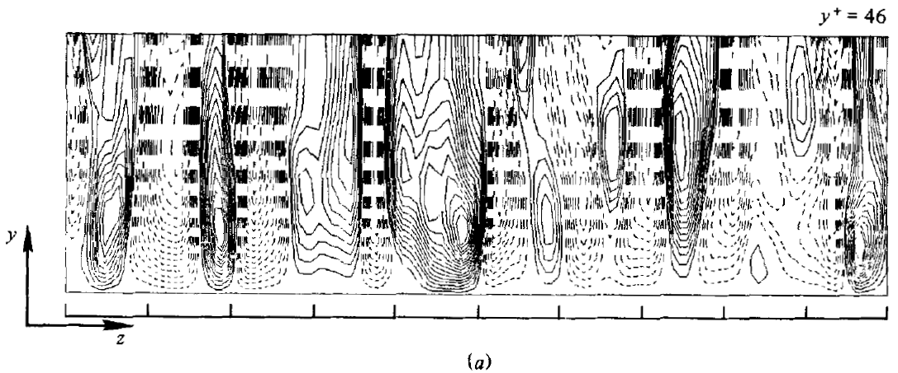
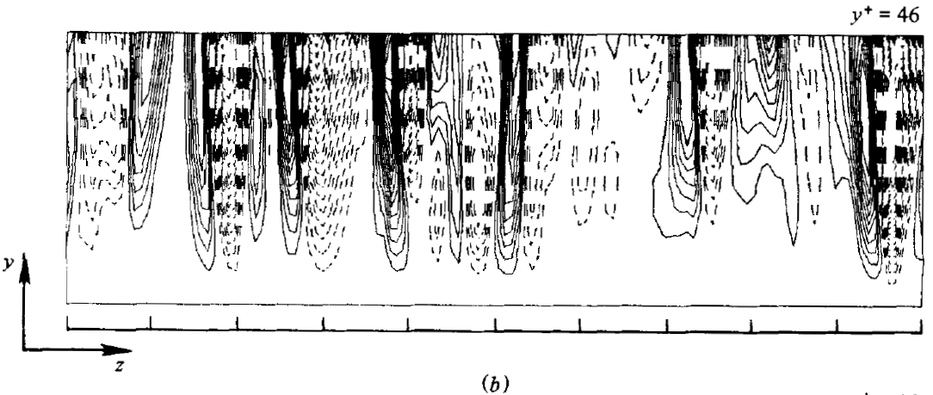
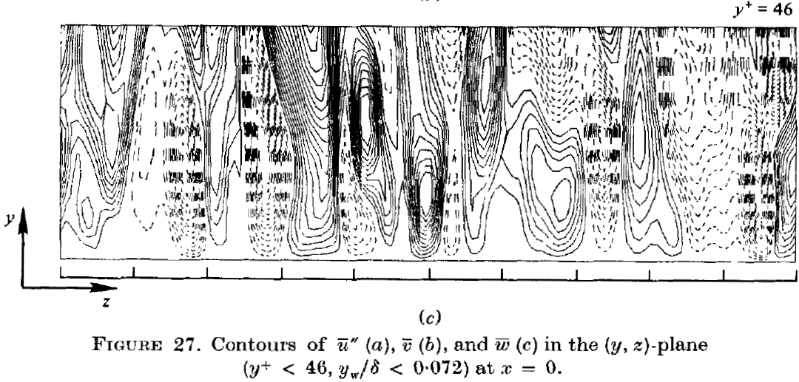
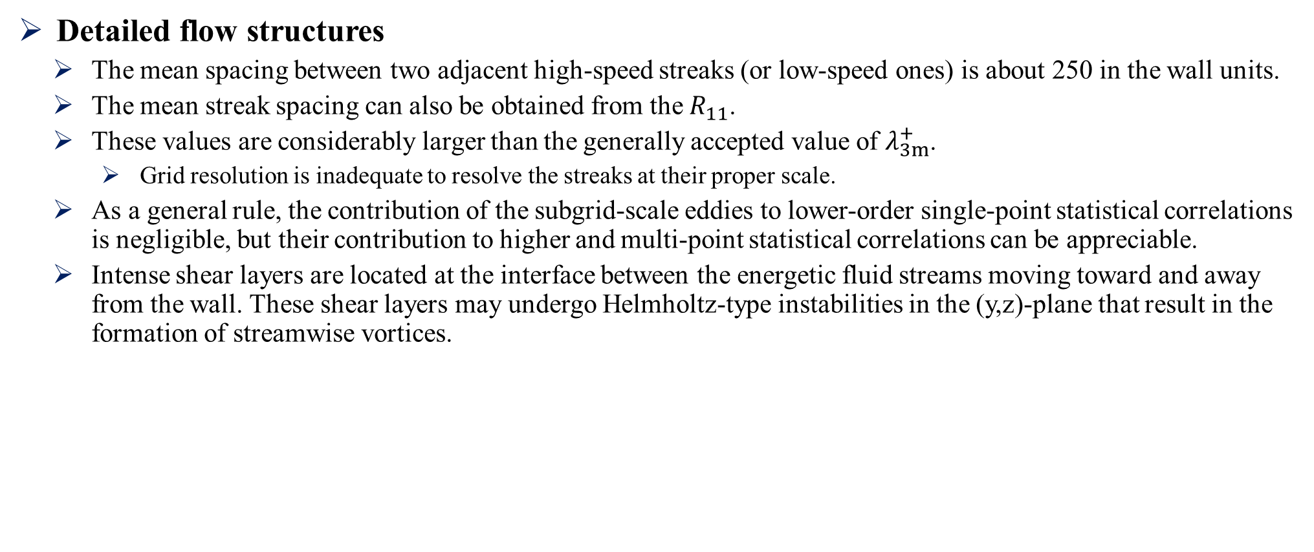
Physics of Turbulent Channel Flow
Detailed flow structures
The mean spacing between two adjacent high-speed streaks (or low-speed ones) is about 250 in the wall units.
The mean streak spacing can also be obtained from the $R_{11}$.
These values are considerably larger than the generally accepted value of $λ_{3m}^{+}$.
Grid resolution is inadequate to resolve the streaks at their proper scale.
As a general rule, the contribution of the subgrid-scale eddies to lower-order single-point statistical correlations is negligible, but their contribution to higher and multi-point statistical correlations can be appreciable.
Intense shear layers are located at the interface between the energetic fluid streams moving toward and away from the wall. These shear layers may undergo Helmholtz-type instabilities in the (y,z)-plane that result in the formation of streamwise vortices.

Slide 19
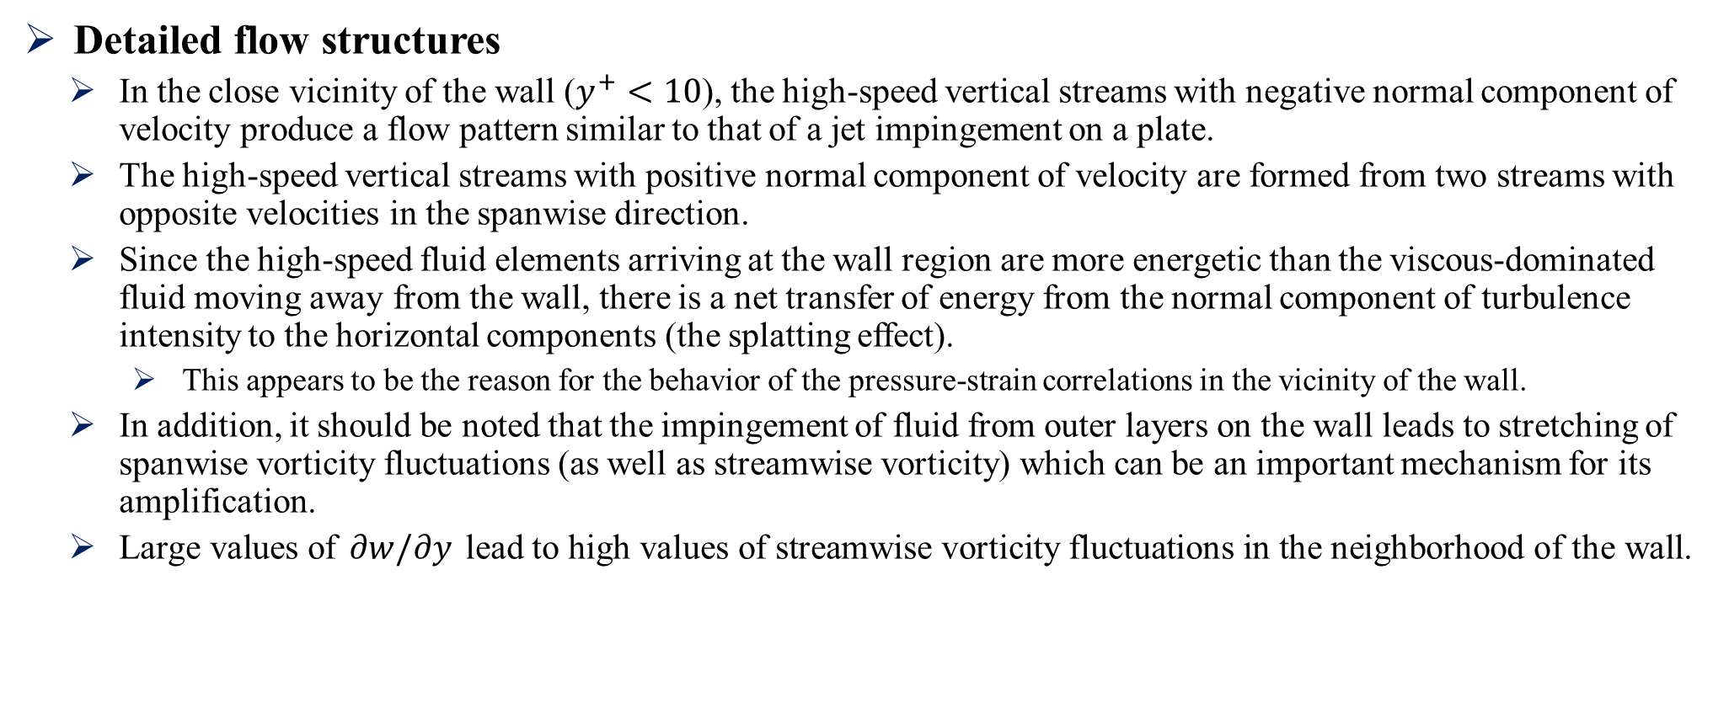
Physics of Turbulent Channel Flow
Detailed flow structures
In the close vicinity of the wall ($y^{+}<10$), the high-speed vertical streams with negative normal component of velocity produce a flow pattern similar to that of a jet impingement on a plate.
The high-speed vertical streams with positive normal component of velocity are formed from two streams with opposite velocities in the spanwise direction.
Since the high-speed fluid elements arriving at the wall region are more energetic than the viscous-dominated fluid moving away from the wall, there is a net transfer of energy from the normal component of turbulence intensity to the horizontal components (the splatting effect).
This appears to be the reason for the behavior of the pressure-strain correlations in the vicinity of the wall.
In addition, it should be noted that the impingement of fluid from outer layers on the wall leads to stretching of spanwise vorticity fluctuations (as well as streamwise vorticity) which can be an important mechanism for its amplification.
Large values of $∂w/∂y$ lead to high values of streamwise vorticity fluctuations in the neighborhood of the wall.

Slide 20
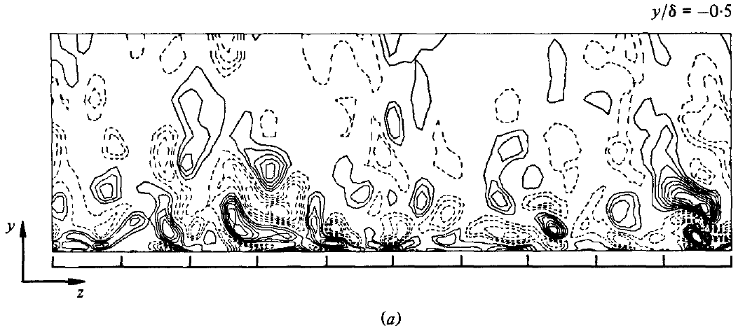
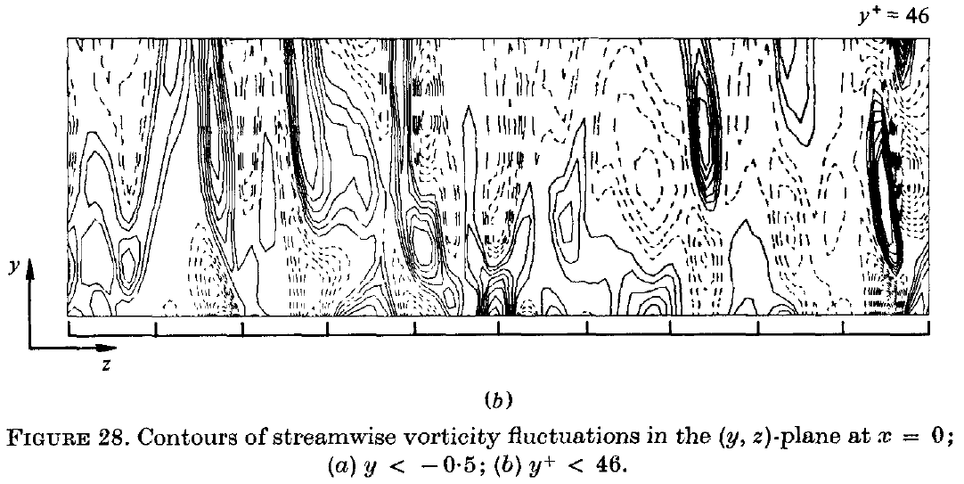
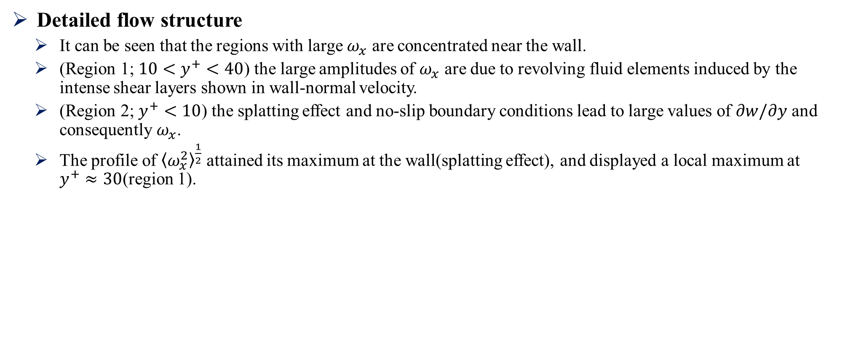
Physics of Turbulent Channel Flow
Detailed flow structure
It can be seen that the regions with large $ω_{x}$ are concentrated near the wall.
(Region 1; $10<y^{+}<40$) the large amplitudes of $ω_{x}$ are due to revolving fluid elements induced by the intense shear layers shown in wall-normal velocity.
(Region 2; $y^{+}<10$) the splatting effect and no-slip boundary conditions lead to large values of $∂w/∂y$ and consequently $ω_{x}$.
The profile of ${\left\langle ω_{x}^{2}\right\rangle }^{\frac{1}{2}}$ attained its maximum at the wall(splatting effect), and displayed a local maximum at $y^{+}≈30$(region 1).

